Slide 1
NAME - 400 Project & Thesis
Supervised by,
Dr. N. M. Golam Zakaria
Professor,
Dept. of NAME,
BUET.
Presented by,
Touseef Hasan
Student ID: 1812044,
Shamsul Islam
Student ID: 1812039.

Slide 2
Tentative Title
“ A Material Flow Analysis of the
Ship-Breaking Industry in Bangladesh
using Machine Learning. ”

Slide 3
Objectives
1. Review the ship-breaking industry in Bangladesh, focusing primarily
on its economic aspects.
2. Develop a machine learning model, using key factors – ship type,
particulars, and historical data to predict the scrap value.
3. Conduct gap analysis of the existing literature and provide a projection
of ship scrap, based on relevant input parameters.
Notes:
Directly related to steel weight: LDT represents the weight of the ship itself, excluding cargo, fuel, and other consumables. Since most ship scrap value comes from the steel hull, LDT provides a baseline estimate of the potential scrap weight.
Simple to calculate: Unlike other tonnage measures like Gross Registered Tonnage (GRT) or Net Registered Tonnage (NRT), LDT doesn't require complex calculations or measurements of internal spaces. It can be readily estimated from the ship's design specifications or displacement data.
GRT/NRT ratio: Comparing GRT and NRT can give an indication of the proportion of space dedicated to cargo and revenue generation. A higher ratio suggests a focus on cargo capacity, potentially implying lighter-weight hull construction and lower scrap value.
Historical scrapping data: If data is available for similar ships previously scrapped, analyzing their actual scrap weight and value can provide valuable insights for more accurate estimation.

Slide 4
Methodology
1. Reviewing Existing Literature
2. Data Collection, Cleaning and Exploratory Data Analysis (EDA)
3. Feature Engineering
4. Machine Learning Model Development, Training & Testing
5. Model Evaluation and Interpretation

Slide 5
Data Collection
Sourced from: Ministry of Industries, Motijheel C/A, Dhaka
Timeline of Collection: July 23, 2023 – December 20, 2023
Interval of Collected Data: January 2012 - November 2023
Total Unique Vessels Recorded: 1497
Ship Types Obtained: 82
Notes:
LDT (Light Displacement Tonnage) represents the weight of a ship when it is completely empty, without any cargo, fuel, water, or supplies. This provides a baseline weight for the ship's structure, which is essential in estimating the total weight of scrap material that can be obtained. NRT (Net Registered Tonnage) represents the internal volume of the ship available for cargo and passengers, after deducting spaces that contribute to the operation of the vessel (engine room, crew quarters, navigation, etc.). GRT (Gross Registered Tonnage) represents the total internal volume of the ship, including all enclosed spaces, regardless of their use.
a.k.a. First Party data, because the data was collected directly from the responsible organization. Internal data, thus unbiased.
Gratitude to our thesis supervisor, collected data over a span of 6 months on Excel. 2018, 2019, 2020 was excluded.
Finding key factors that impact scrap (LDT), correlation vs. causation!

Slide 6
Data Pre-Processing/Cleaning
Removing duplicates Finding unique data points
Fixing structural errors Standardizing units for a certain parameter
Excluding outliers Ensuring a better fit
Notes:
80-90% time was spent on data collection and cleaning.

Slide 7
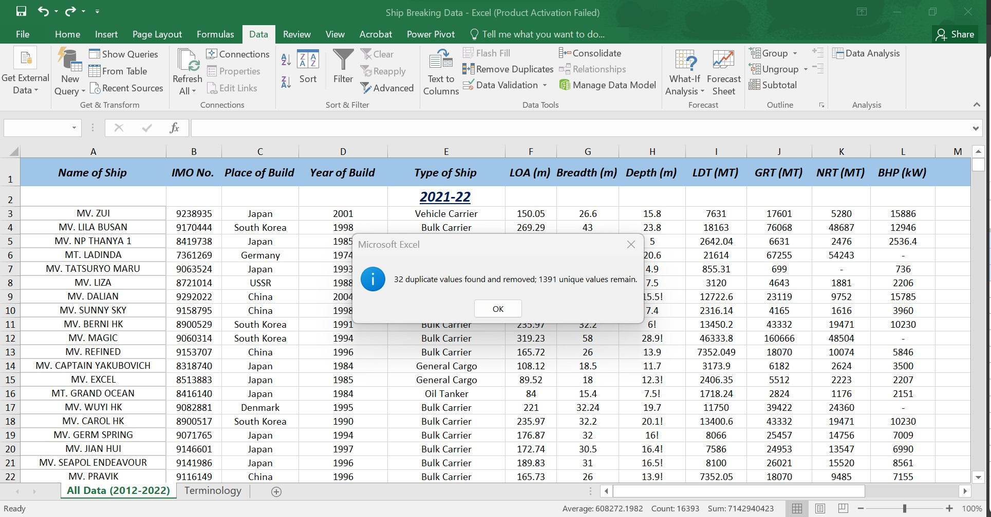
Data Pre-Processing/Cleaning (contd.)
Figure: Removal of duplicate values
Notes:
Done on Excel.

Slide 8
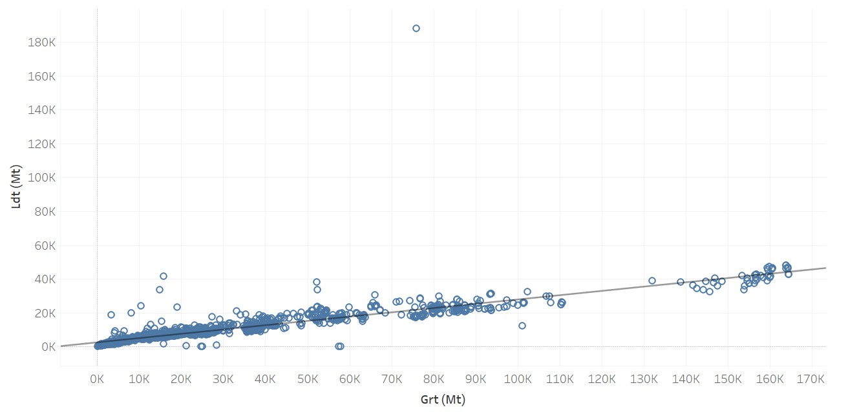
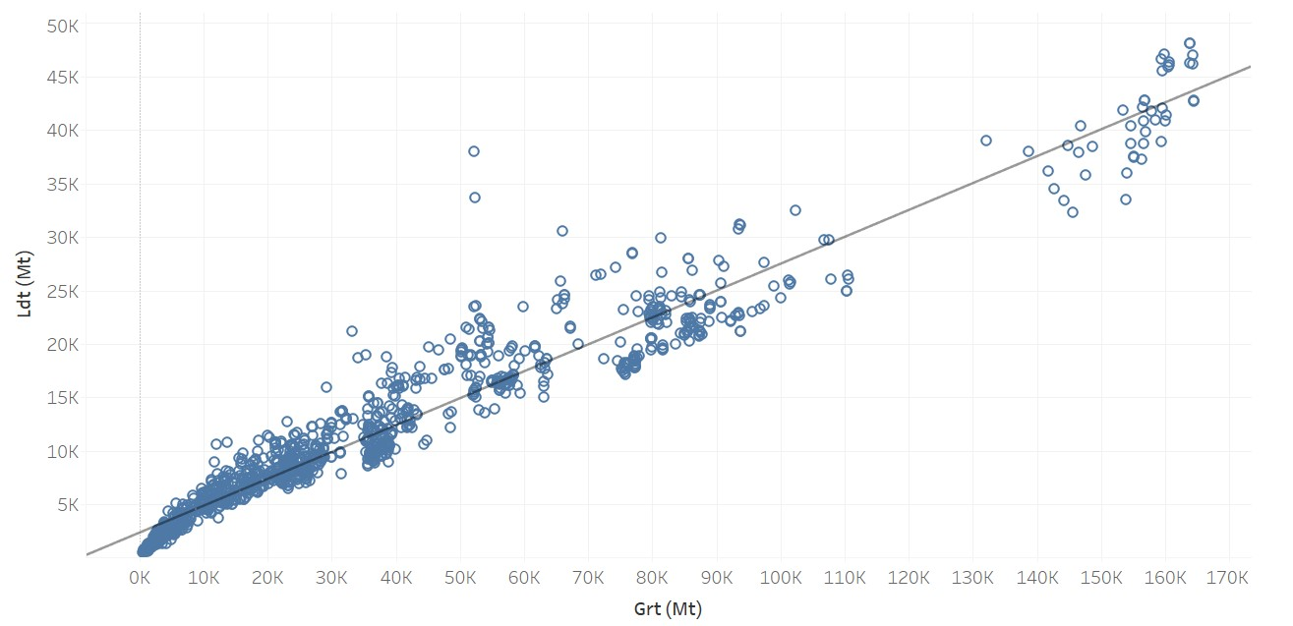
Data Pre-Processing/Cleaning (contd.)
Figure: Before excluding outliers
Figure: After excluding outliers
Notes:
Done on Tableau. Logical errors (LDT > GRT) were also excluded. If LDT > GRT, it would imply that the ship's structural components and equipment are heavier than the entire volume of the ship, which is physically impossible.

Slide 9
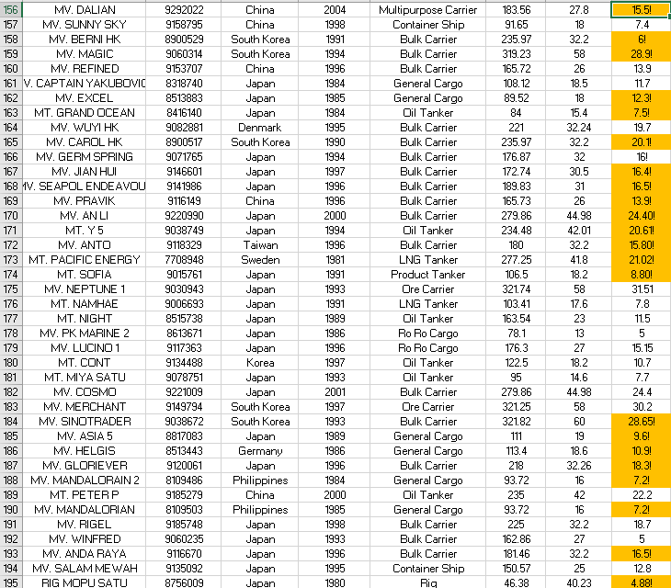
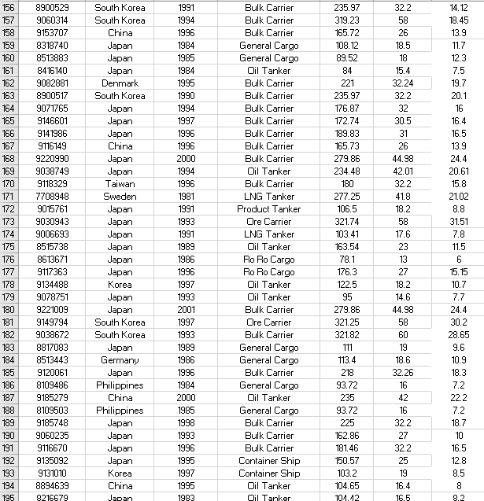
Data Pre-Processing/Cleaning (contd.)
Figure: Before depth correction (Orange boxes)
Figure: After depth correction (Orange boxes cleared)
Notes:
According to ship type, linear regression formula was used.
L vs. Depth: R^2 value rose from 0.28 to 0.82.

Slide 10
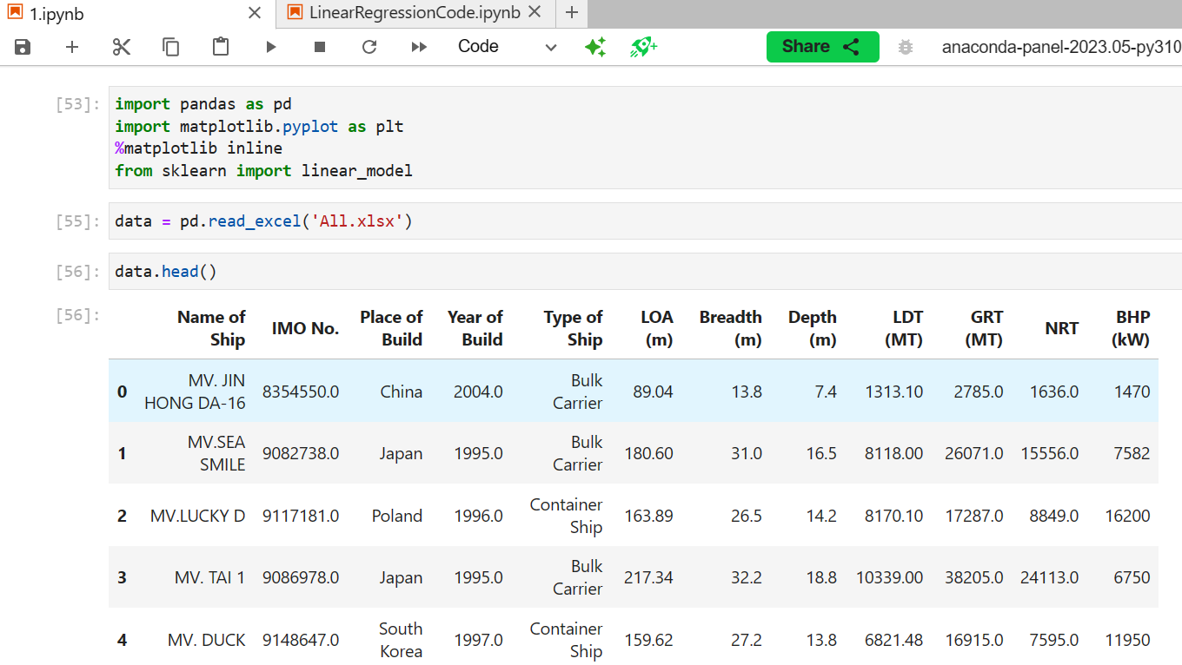
Exploratory Data Analysis
Notes:
EDA is analyzing data to understand the data, discover patterns and spot anomalies. Visualize distributions, summary statistics, identify outliers.
Answer: main features? outliers? Missing values? Relationship between variables? Trends?

Slide 11
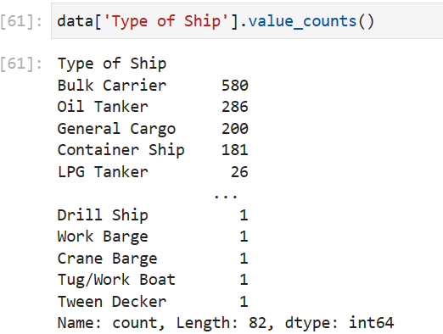
Exploratory Data Analysis (contd.)
Notes:
Done on Jupyter Notebook. Coded in Python. Libraries used: Pandas, Matplotlib, Sklearn, Seaborn.

Slide 12
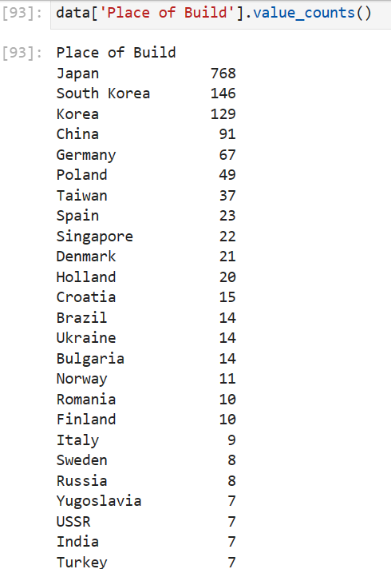
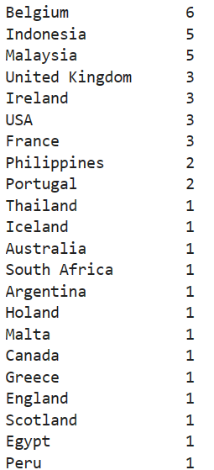
Exploratory Data Analysis (contd.)

Slide 13
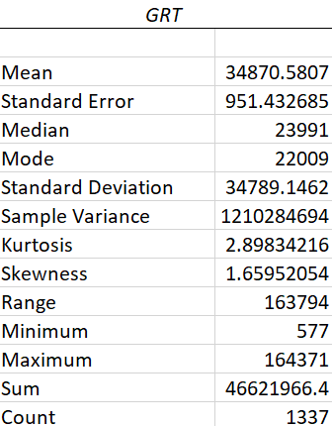
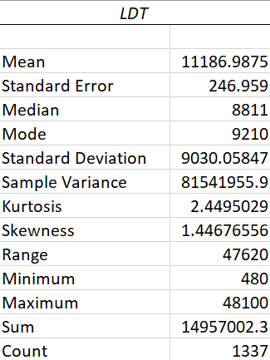
Exploratory Data Analysis (contd.)
Figure: EDA for all unique ships, taking GRT and LDT as key parameters

Slide 14
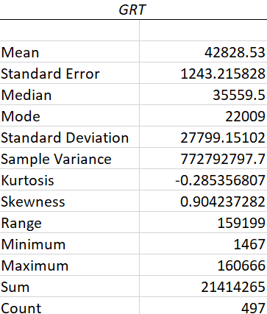
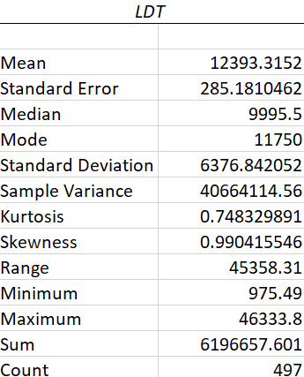
Exploratory Data Analysis (contd.)
Figure: EDA for all bulk carriers, taking GRT and LDT as key parameters

Slide 15
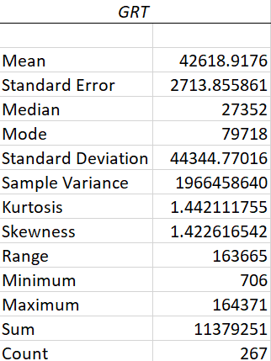
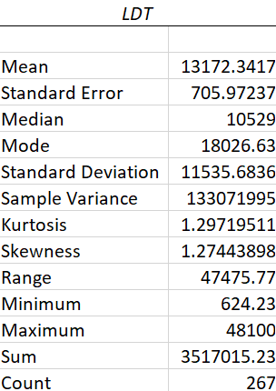
Exploratory Data Analysis (contd.)
Figure: EDA for all oil tankers, taking GRT and LDT as key parameters

Slide 16
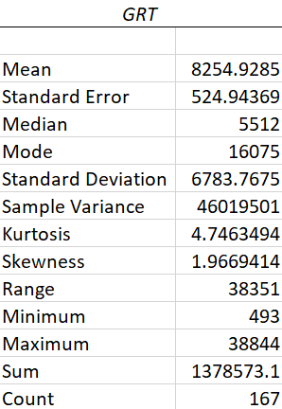
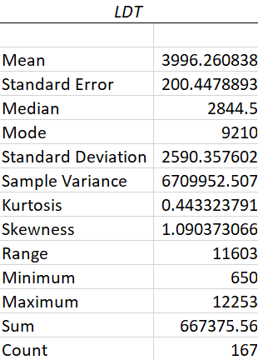
Exploratory Data Analysis (contd.)
Figure: EDA for all cargo vessels, taking GRT and LDT as key parameters

Slide 17
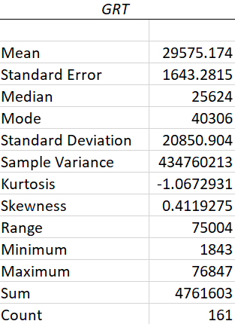
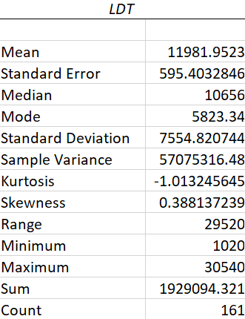
Exploratory Data Analysis (contd.)
Figure: EDA for all container ships, taking GRT and LDT as key parameters

Slide 18
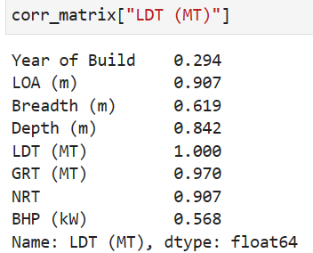
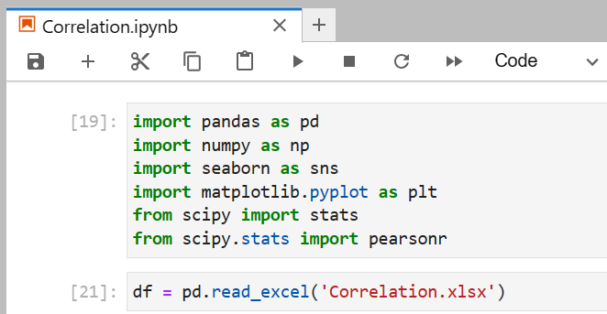
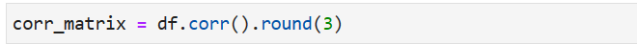
Feature Engineering
Notes:
Feature Engineering is the process of improving the performance of a machine learning model by selecting, transforming, and creating new variables based on domain knowledge and the characteristics of the dataset.

Slide 19
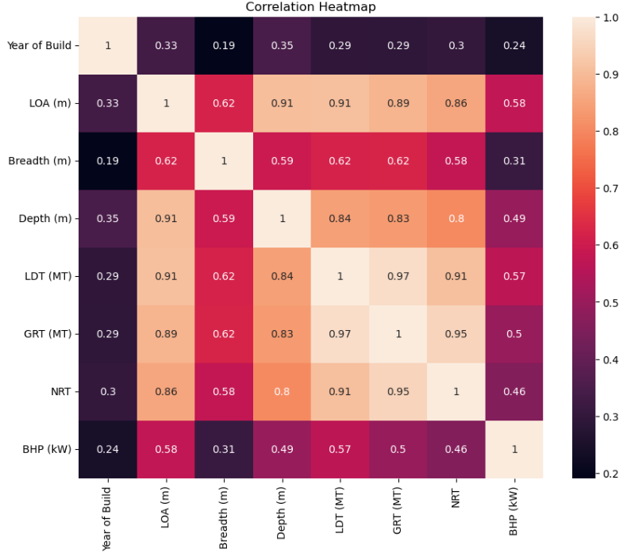
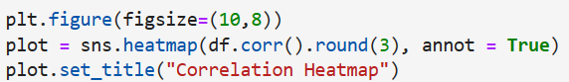
Feature Engineering (contd.)
According to the Pearson correlation coefficient (from the heatmap),
Length (0.91), depth (0.84) and GRT (0.97) has the highest correlation with LDT.
Notes:
1 indicates a perfect positive correlation, meaning that as one variable increases, the other increases proportionally.
-1 indicates a perfect negative correlation, meaning that as one variable increases, the other decreases proportionally.
0 indicates no linear relationship between the variables.
The absolute value of the r-value tells you the strength of the relationship, regardless of whether it's positive or negative.

Slide 20
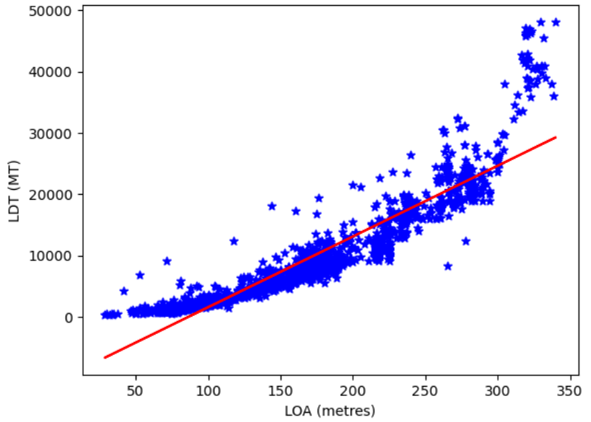
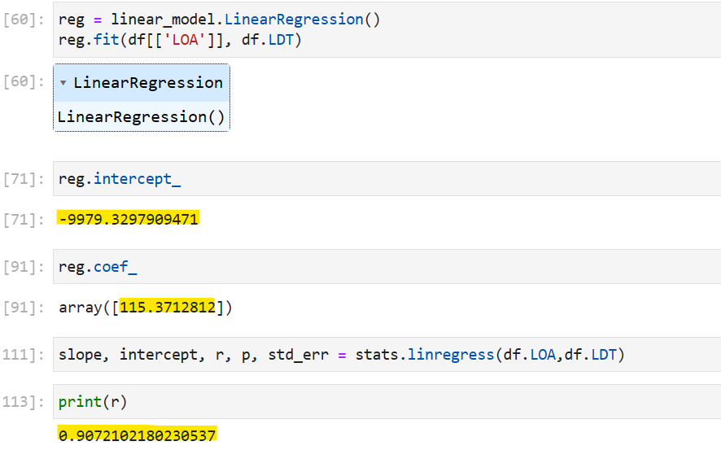
Machine Learning Model Development
Linear Regression Model
Notes:
ML → Supervised Learning → Continuous measurement prediction → Regression models

Slide 21
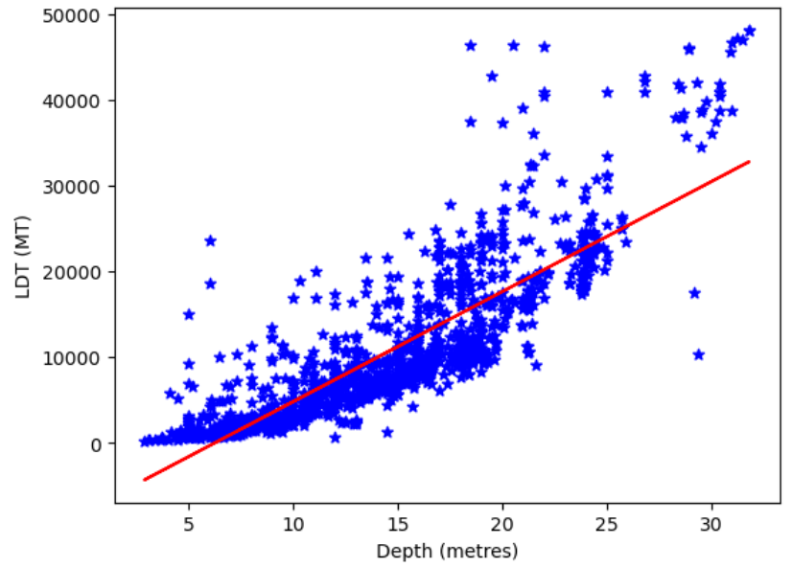
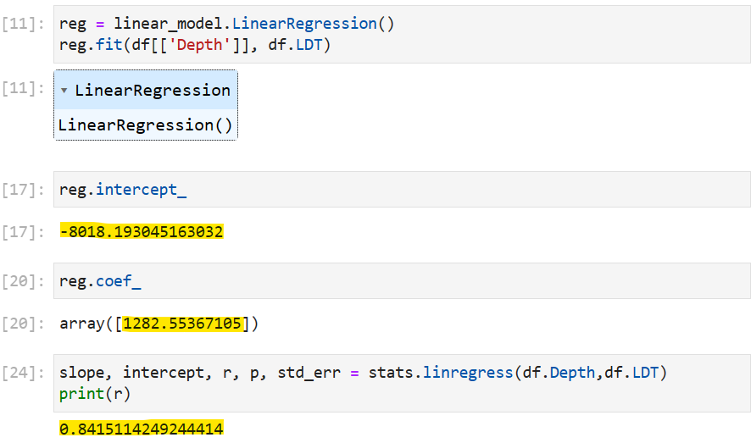
Machine Learning Model Development
Linear Regression Model (contd.)

Slide 22
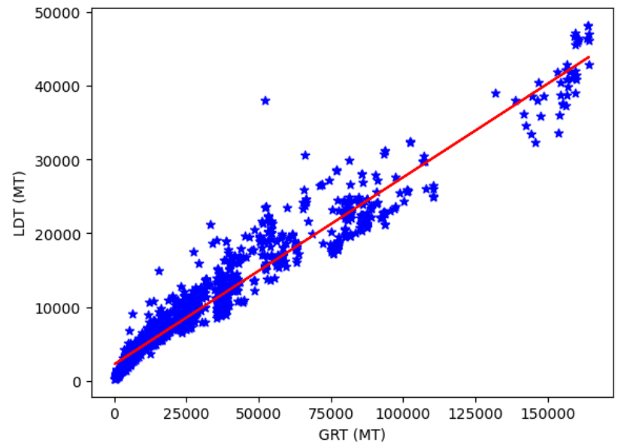
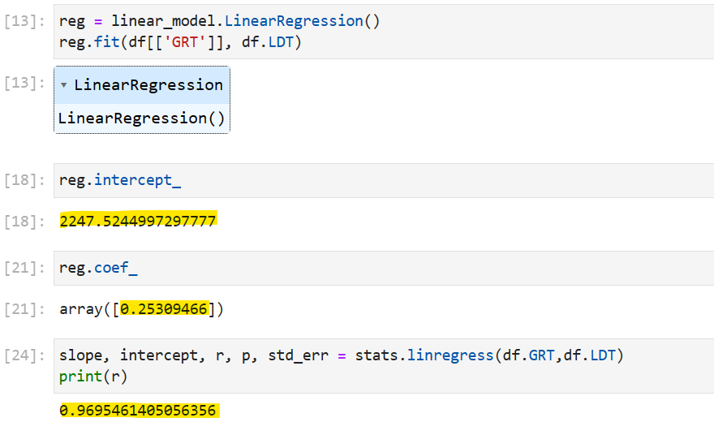
Machine Learning Model Development
Linear Regression Model (contd.)

Slide 23
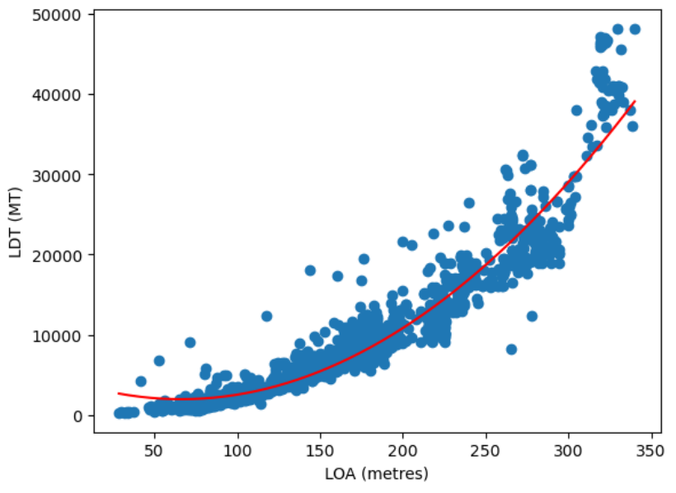
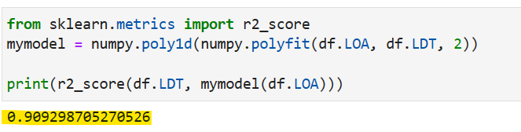
Machine Learning Model Development
Polynomial Regression Model: 2nd Order

Slide 24
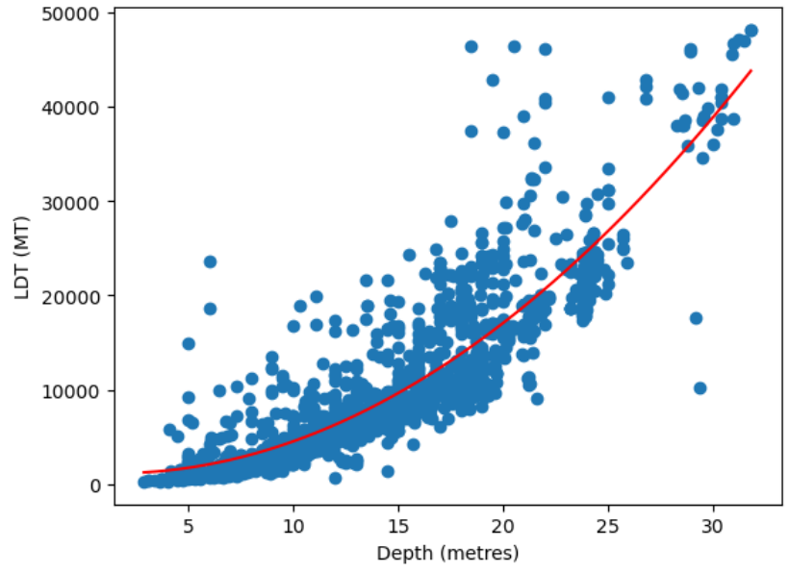
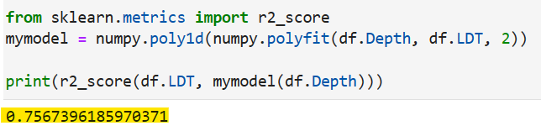
Machine Learning Model Development
Polynomial Regression Model: 2nd Order

Slide 25
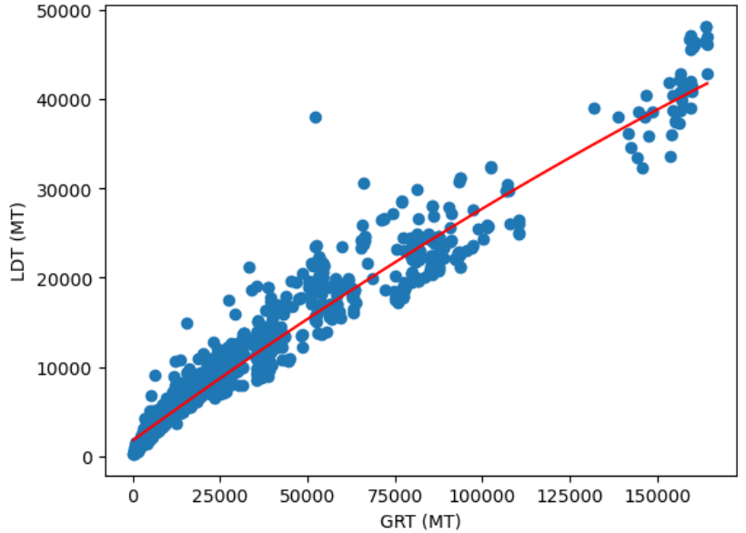
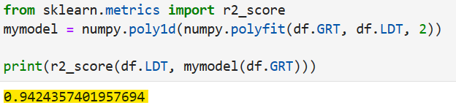
Machine Learning Model Development
Polynomial Regression Model: 2nd Order

Slide 26
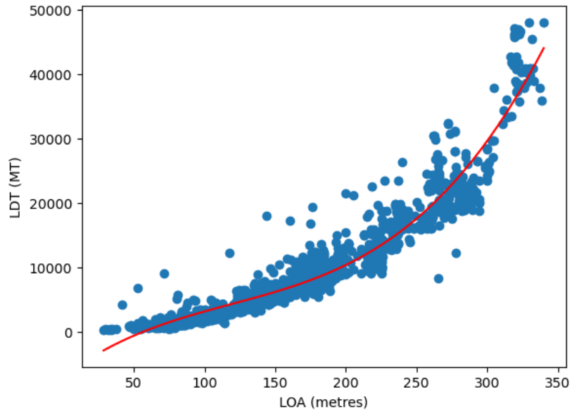
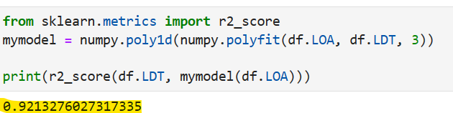
Machine Learning Model Development
Polynomial Regression Model: 3rd Order

Slide 27

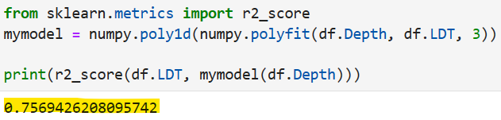
Machine Learning Model Development
Polynomial Regression Model: 3rd Order

Slide 28
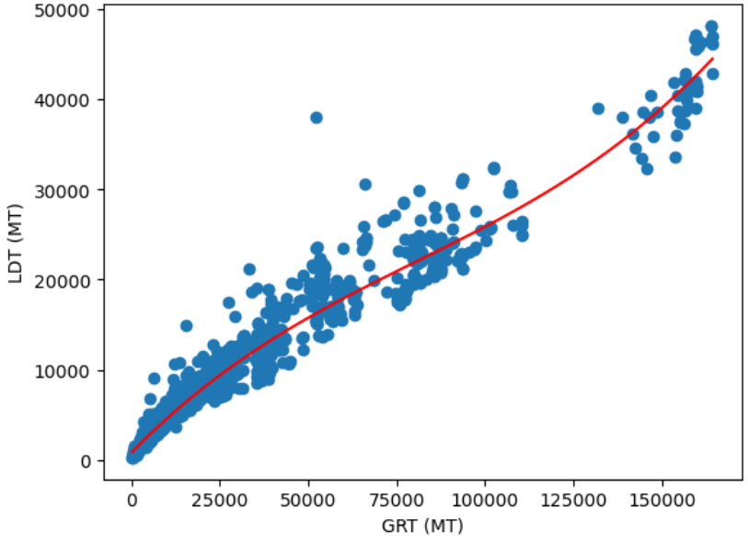
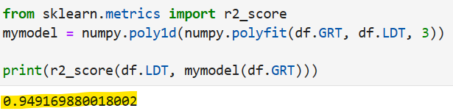
Machine Learning Model Development
Polynomial Regression Model: 3rd Order

Slide 29
Machine Learning Model Development
Finding the Best Regression Model
(Predicting LDT from various input parameters)
Value of R-squared | Linear | Polynomial (2nd Order) | Polynomial (3rd Order)
LOA vs. LDT | 0.907 | 0.909 | 0.921
Depth vs. LDT | 0.841 | 0.757 | 0.757
GRT vs. LDT | 0.969 | 0.942 | 0.949
Notes:
No definite answer to this question.
Consider Algorithm Characteristics:
Interpretability: How easily model decisions can be explained (e.g., Decision Trees, Linear Regression)
Accuracy: Ability to correctly predict outcomes
Computational Cost: Time and resources required for training and prediction
Overfitting: Tendency to model training data too closely, reducing generalization
Robustness: Ability to handle noisy or missing data
Tune Hyperparameters: Adjust algorithm settings to optimize performance
Evaluate Performance: Use appropriate metrics (accuracy, precision, recall, F1-score, AUC-ROC for classification; MSE, MAE, R-squared for regression
There's no one-size-fits-all algorithm. Experimentation and evaluation are crucial.
Consider trade-offs between accuracy, interpretability, computational cost, and other factors.

Slide 30
Upcoming Work
1. Finding the Algorithm that fits best for the Model
2. Training Data for Model Development
3. Testing Data for Model Evaluation and Interpretation

Slide 31
References
Ministry of Industries, Motijheel C/A, Dhaka.
Hossain, A., Iqbal, K.S. and Zakaria, N.M.G.; Ship Recycling Prospects in Bangladesh, December, MARTEC 2010, Bangladesh.
Shameem, A.B.M; The Role of the Ship Breaking Industry in Bangladesh and its Future with Special Emphasis on Capacity Building Through Education and Training, M.Sc Thesis, 2012, World Maritime University, Sweden.
Rahman, Sohanur; Aspects and Impacts of Ship Recycling in Bangladesh, MARTEC 2016.
N. M. Golam Zakaria, Mir Tareque Ali and Kh. Akhter Hossain; Underlying Problems of Ship Recycling Industries in Bangladesh and Way Forward, Journal of Naval Architecture and Marine Engineering, December, 2012.
Hasan Ruhan Rabbi, Aevelina Rahman; Ship Breaking and Recycling Industry of Bangladesh; Issues and Challenges, MARTEC 2016.

Slide 32
Thank You

